Slide 1

Pharmacy Management System

Slide 2
Importance of the Project
Daily Operations Automation: To reduce human errors and accelerate customer service.
Accurate Inventory Management: Monitoring expiration dates and quantities, and preventing the sale of expired medications.
Decision-Making Support: Providing analytical reports and better management of purchasing, sales, and profitability processes.
Security and Scalability: Protecting data through user access permissions and the ability to connect multiple branches in the future.

Slide 3
MAIN OBJECTIVE OF PROJECT
Comprehensive and Integrated Solution Development: To manage pharmacy operations efficiently.
Comprehensive Management: Tracking sales, purchases, inventory, medications, suppliers, and invoices to reduce human errors.
Reporting and Decision Improvement: Providing intelligent reporting features and data analysis to support decision-making.
Security and Usability: Protecting data through permission controls and encryption, featuring a user-friendly interface built using PyQt5.

Slide 4
Problems Solved by the Project
Inventory Tracking Issues: Difficulty in manually monitoring expiration dates, stock quantities, and hazardous materials.
Human Errors and Lack of Reporting: Frequent errors in sales transactions and the absence of clear reports for decision-makers.
Employee Monitoring and Permissions: Difficulty in organizing work shifts, attendance records, and accurately defining user permissions.
Lack of Smart Systems: Absence of alerts for drug interactions and the failure to suggest therapeutic alternatives when medications are unavailable.
Process Fragmentation and Audit Logs: Lack of integration for supplier and invoice data in a single place, along with the absence of audit logs.

Slide 5
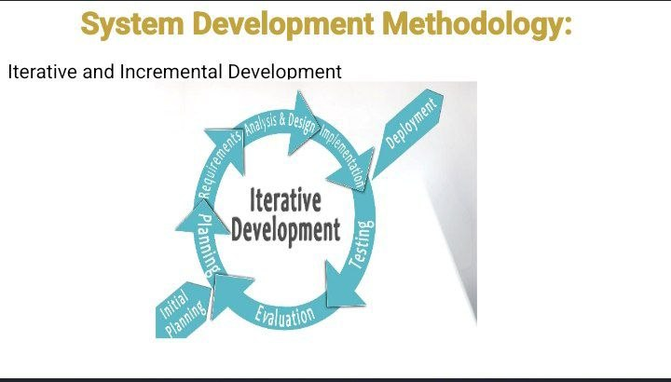
METHODOLOGY Used in the project

Slide 6
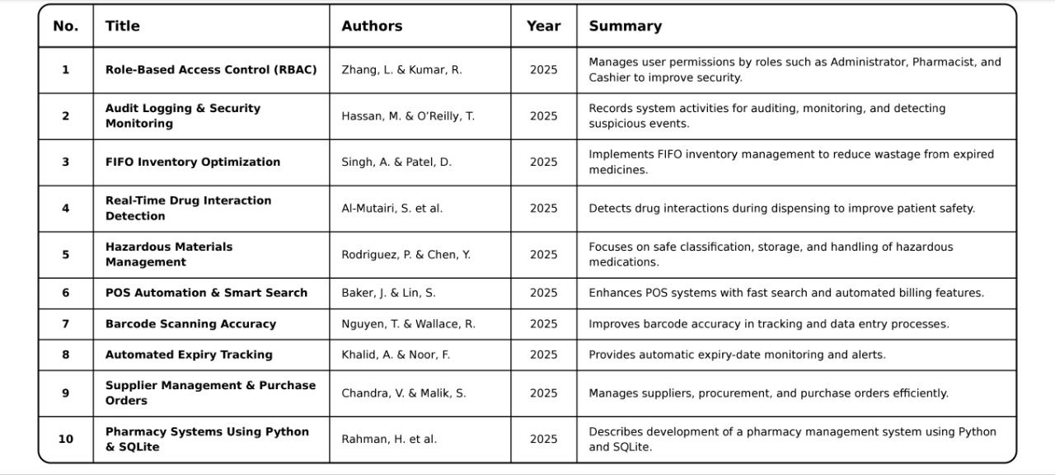
Research Papers

Slide 7
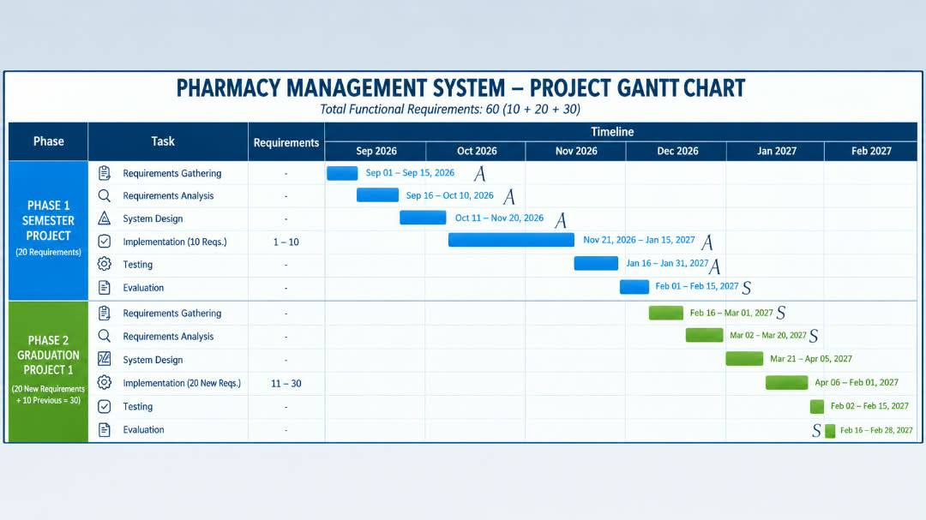
GANTT CHART

Slide 8
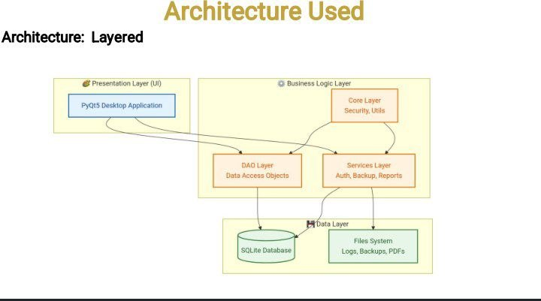

Slide 9
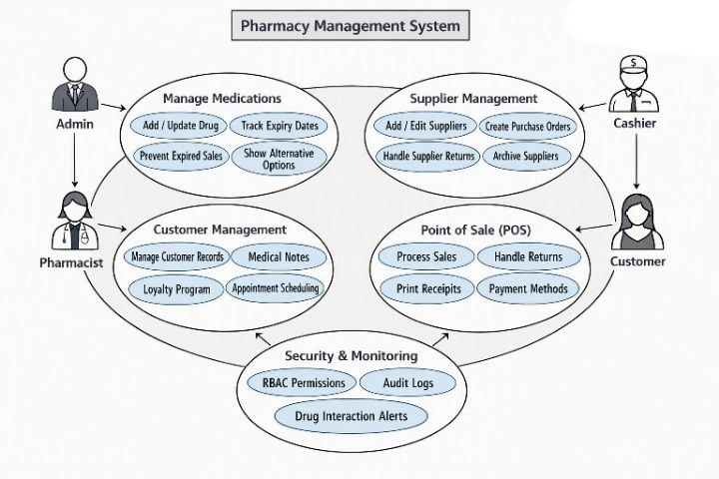

Slide 10
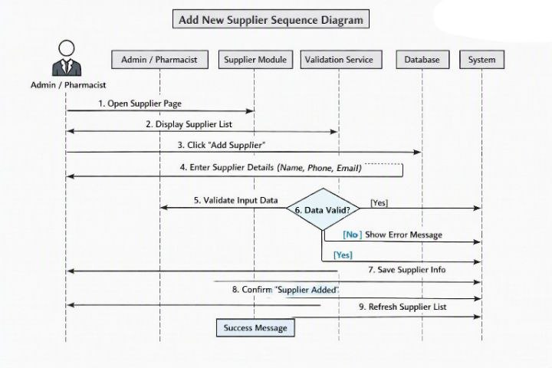

Slide 11
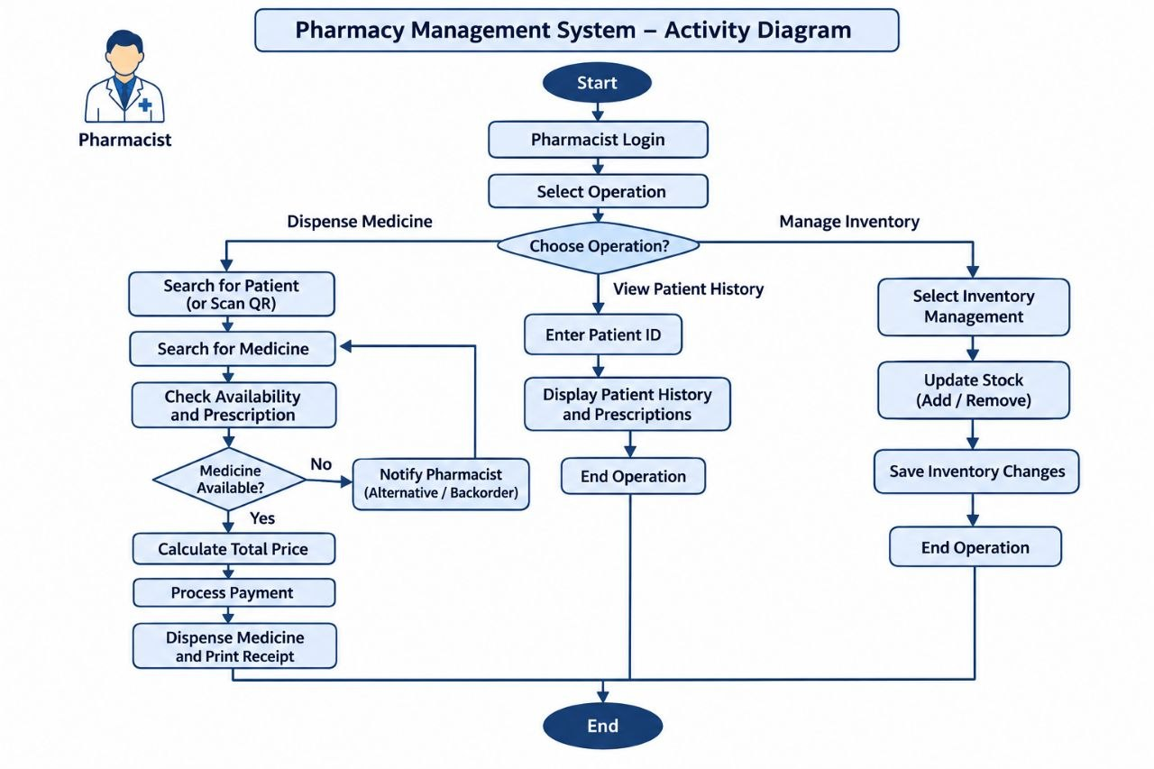

Slide 12
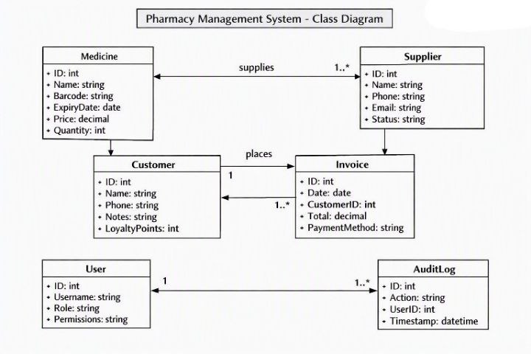

Slide 13
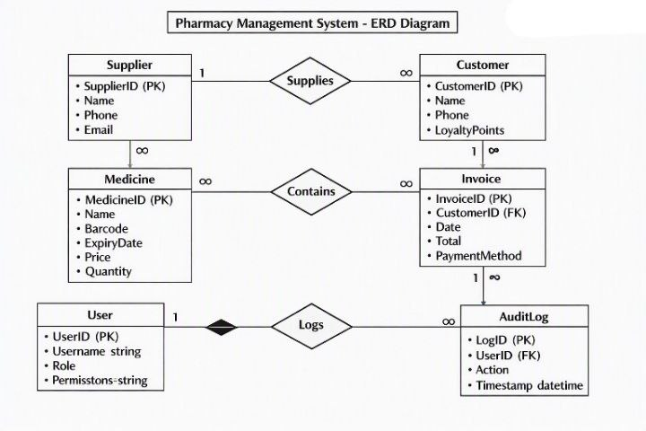

Slide 14
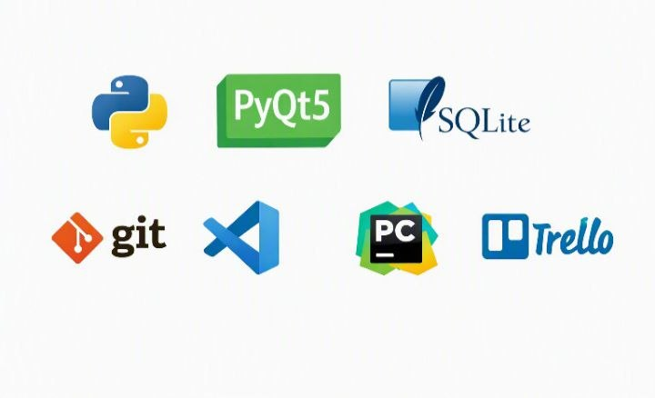
Languages, work environment and tools used

Slide 15


